Slide 1


FAST X

Slide 2
FARM ORIZON
Why?
Explain why you want to pursue this business idea
Many people have a deep passion for agriculture and a strong desire to support local farmers and promote sustainable farming practices. They see this business as a way to combine their love for agriculture with entrepreneurship.
Purpose Statement:
To empower local communities, support sustainable agriculture, and enrich the lives of consumers by establishing a transparent, efficient, and community-driven platform that connects farmers with individuals seeking fresh, locally sourced agricultural products.”
Mission Statement:
At “Farm Orizon” our mission is to transform the way people access and enjoy agricultural products by fostering a vibrant and sustainable ecosystem.

Slide 3
Problems
Problem 1: Sourcing Consistency Farmers might have fluctuations in supply due to weather, crop seasons, and other variables. Inconsistent supply can lead to customer dissatisfaction and operational challenges.
Problem 2: Logistics and Delivery Efficient delivery and logistics can be challenging, especially when dealing with perishable products. Ensuring timely deliveries without compromising product quality is critical.
Problem 3: Customer Trust and Market Education Building trust with customers and educating them about the benefits of your platform can be an initial hurdle. Consumers may be skeptical about the quality and sourcing of products.

Slide 4
Solutions
Solution 1: Diversify Your Supplier Network
Work with a network of farmers that grow a variety of crops with different harvesting seasons to ensure a more consistent supply.
Solution 2: Streamlined Delivery Operations
Invest in a well-planned delivery and distribution system that optimizes routes and minimizes transportation time.
Use temperature-controlled storage and transportation to maintain product freshness.
Solution 3: Building Trust and Education
Develop a comprehensive marketing strategy that emphasizes transparency and the benefits of buying directly from local farmers.
Create educational content and resources on your platform that explain the advantages of local, fresh produce, sustainable farming, and the positive impact on the community.

Slide 5
Market
The market for your Farm Orizon, which connects farmers with consumers for the sale of agricultural products, is composed of several interconnected segments. To effectively reach and serve your target market, it's important to understand these segments.
Farmers and Agricultural Producers
Consumers
Restaurants and Food Service Providers
Grocery Stores and Markets
Online Shoppers
Community Supported Agriculture (CSA) Programs
Event Planners and Caterers

Slide 6
Competition
Online Farmers' Markets: Platforms that focus on connecting consumers with local farmers and offer a wide range of agricultural products. Examples include Farmigo and LocalHarvest.
Grocery Delivery Services: Both traditional grocery stores and online retailers provide delivery services that include fresh produce and agricultural products. Examples include Instacart, Amazon Fresh, and FreshDirect.
Community Supported Agriculture (CSA) Programs: Subscription-based models that connect consumers with local farms for regular deliveries of fresh produce.
Local Farmers' Markets: Physical markets where local farmers sell their products directly to consumers. While not direct online competition, they share a similar mission of connecting consumers with local agriculture.
Regional and Local Online Marketplaces: Some regions have specific online platforms that cater to the sale of local agricultural products.

Slide 7
Marketing/Sales Strategy
Identify Your Target Audience:
Segment your market to understand the specific needs and preferences of various customer groups, including consumers, restaurants, and other businesses.
Build a Strong Online Presence:
Develop an attractive, user-friendly website and/or mobile app.
Optimize your platform for search engines to improve its visibility.
Content Marketing:
Create engaging and informative content, such as blog posts, videos, and infographics, related to local agriculture, sustainability, and the benefits of farm-fresh products.
Use content to educate and inspire your audience.

Slide 8
Team
Co-founders: Daniel J (CEO), Soorya K (CFO), and Bharath Kumar S (CMO),Hariharan K (MANAGER).
Daniel J has 10 years of experience in sustainable transportation.
Soorya K led the development of a successful ride-sharing app.

Slide 9
Financial Projections
Cost Structure
List your fixed and variable costs - $5 Million
Customer acquisition costs - $1 Million
Distribution costs - $2 Million
Hosting - $2 Million
People - $10 Million
Revenue Structure
List your sources of revenue – $1 Billion
Revenue Model – $2 Million
LifeTime Value – $5 Billion
Revenue – $8 Million per Month
Gross Margin – $10 Million

Slide 10
Vision
1.Local Agriculture Thrives: Our platform becomes the lifeline for local farmers, helping them prosper through sustainable practices and ethical partnerships.
2. Consumers Are Empowered: People have the knowledge and means to make informed, healthy, and conscious choices about the food they consume.
3. stainability Prevails: Sustainability is no longer a choice but a way of life. We lead by example in reducing carbon footprints and promoting eco-friendly practices.
4.Food Waste Is Minimized: Our commitment to efficiency reduces food waste, contributing to a more sustainable and responsible future.
5.Quality Is Non-Negotiable: People can't imagine anything less than the freshest, highest-quality agricultural products on their plates.
6. Transparency Reigns: Every bite of food comes with a story and a face behind it. We've created an ecosystem where transparency and trust are cornerstones of every transaction.

Slide 11
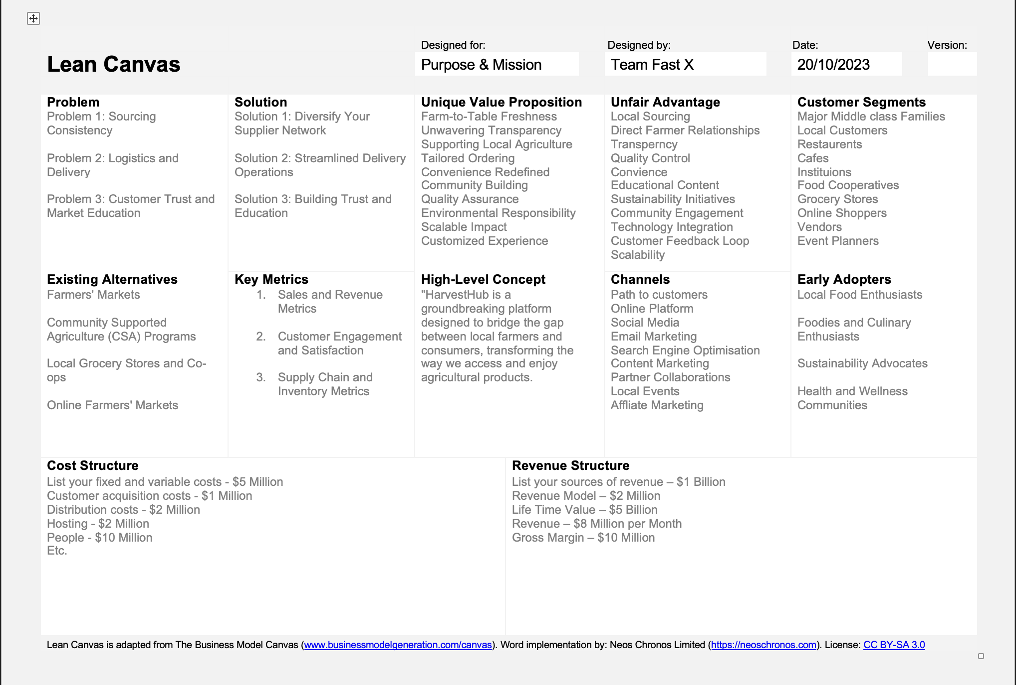

Slide 12
THANK YOU

